Slide 1
DEEL CA2 Part A - GAN
2B04 - Raymond Ng

Slide 2
Abstract - Background Research
Purpose of this assignment was to create a GAN model and evaluate the performance of this network on the CIFAR10 dataset and then proceed to create 1000 small colour images.
Generative Adversarial Networks (GAN) is a machine learning model where 2 neural networks of Generator and Discriminator compete in a zero-sum game to become more accurate in predictions. GANs are difficult to train due to mode collapse and non-convergence. Models created may be unstable and take longer amounts of time to train. Thus, I attempted multiple different architectures to find the best one for this context of CIFAR-10.

Slide 3
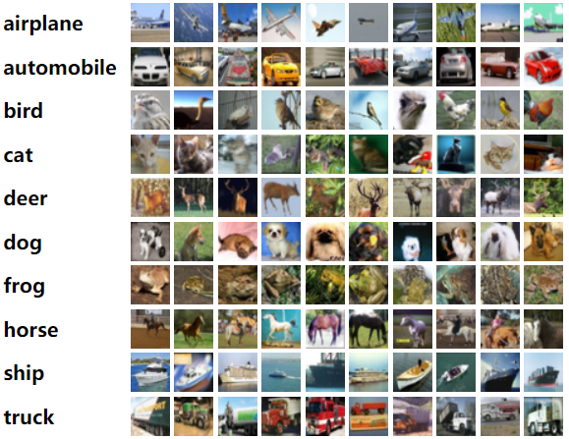
Dataset
GAN image generation was done on the CIFAR-10 dataset
Experimented with not just conditional GAN
60,000 Images of 32x32 size
50,000 images for training, 10,000 for validation was concatenated together
10 Classes with labels specified for CGANs

Slide 4
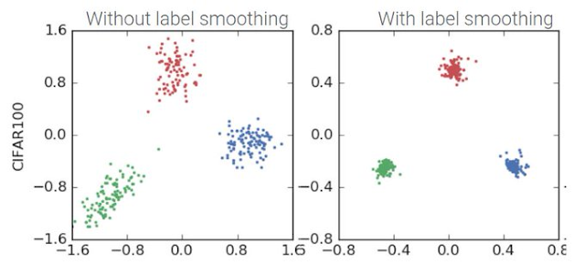
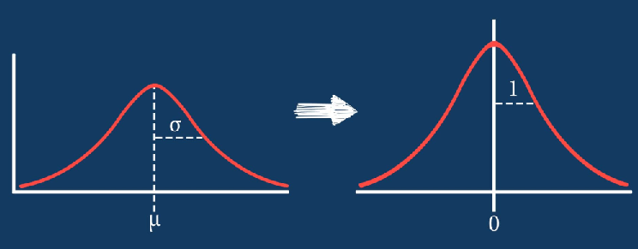
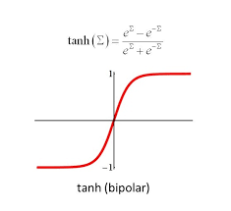
Data Preprocessing
Data is normalized with 0.5 values as recommended in a technical paper
Mean and Std values were calculated from CIFAR-10 and used later on for transforms
GANs don’t require a training and testing set thus, datasets are concatenated
Pixel Normalization of between -1 and 1 is used on real images since generator output of ‘tanh’, this is to ensure similar data scales to generated image
Label smoothing was introduced to increase robustness and classification for my conditional models to prevent them from being overly confident
Transformed the data to tensor and put into data loader
Experiemented with other normalizations including spectral norm

Slide 5
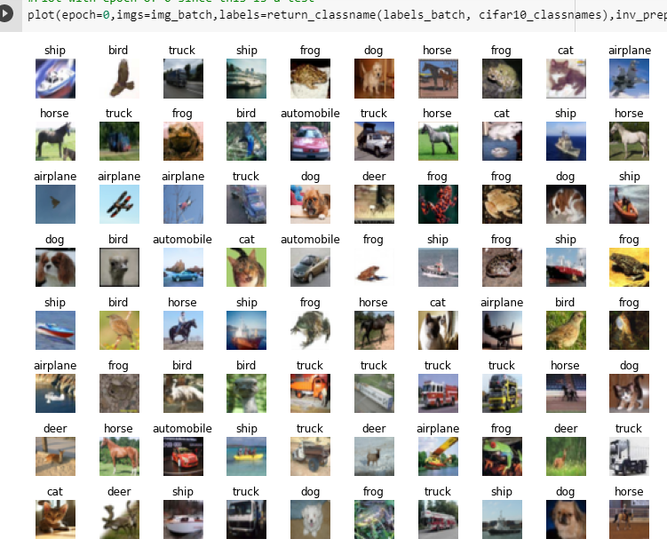
Visualizations
Since normalized images are used to train GAN, GAN will product images in that same range, Inverse normalize calculated to be used on the output to see the visualizations
Plot image in batches with their labels, this plot function is used to save image in wandb as well
Create grid of images and allow the batches to be saved

Slide 6
Feature Engineering or Modeling Helper Functions
return_classname() is to return the classnames based on label tensor
plot() is to generate plots of image batch for visualization and saving on wandb and files
save_gen_img() saves the image in a specific file, along with labels, generating 1000 images of 100 for each class
create_noise() creates the noise vector
Label_real and label_fake is to create real and fake labels, real=1, fake=0
weights_init() is to weight initialize the model based on layers it has
D_hinge and g_hinge is from Hinge loss from https://github.com/POSTECH-CVLab/PyTorch-StudioGAN/blob/8c9aa5a2e9bb33eca711327c085db5ce50ff7fc0/src/utils/losses.py
train_batch() is to train one batch of images
evaluate() is to evaluate with FID and IS Score and log it into wandB

Slide 7
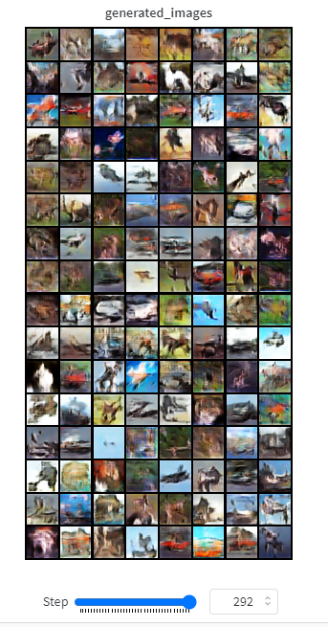
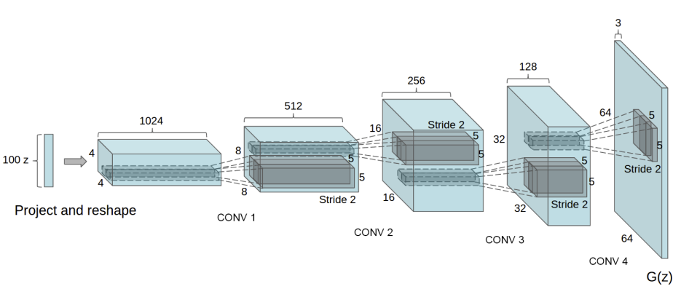
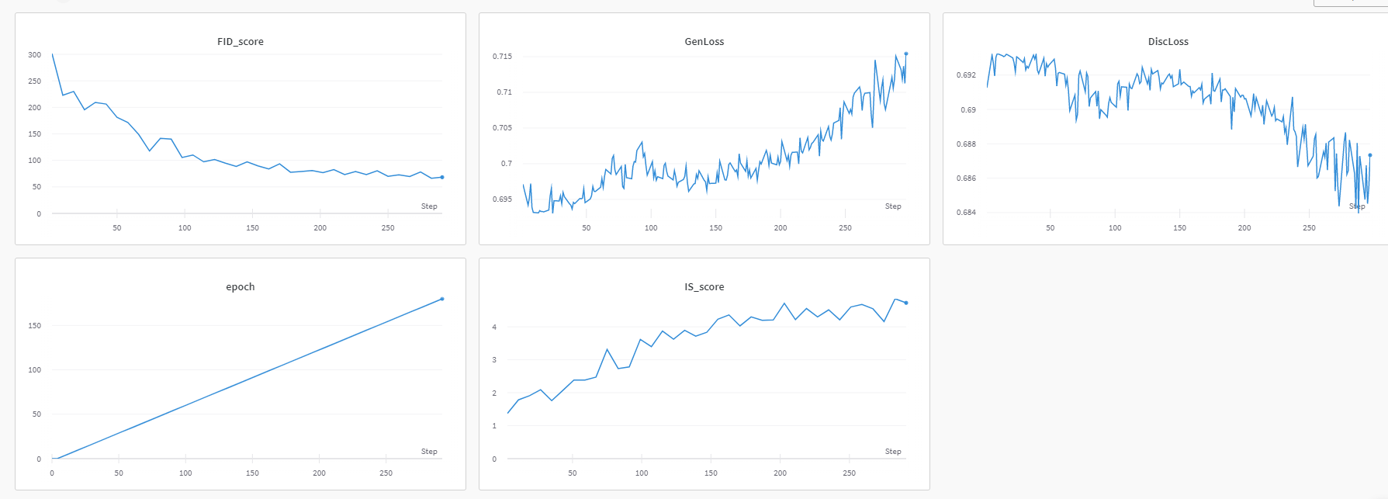
DCGAN
DCGAN was the first architecture attempted
Code was inspired from the technical paper
https://arxiv.org/abs/1511.06434v2
Using convolution layers that are similar to the ones used in CA1 CNNs to make a DCGAN
Experimented with DCGAN with best run of FID: 68 and IS:4.7
However Gen Loss had unstable upwards trend which shouldnt be happening. In other runs, FID: 150, IS: 2.7 but good loss trends

Slide 8
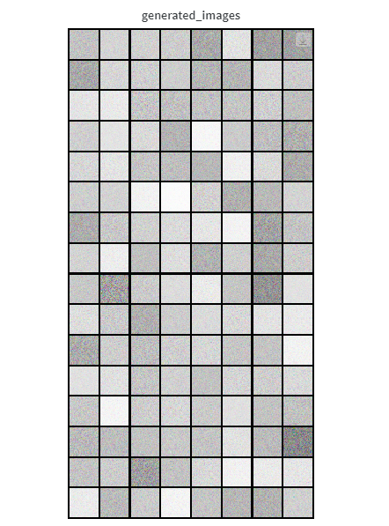
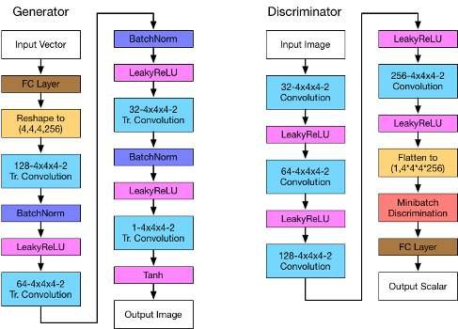
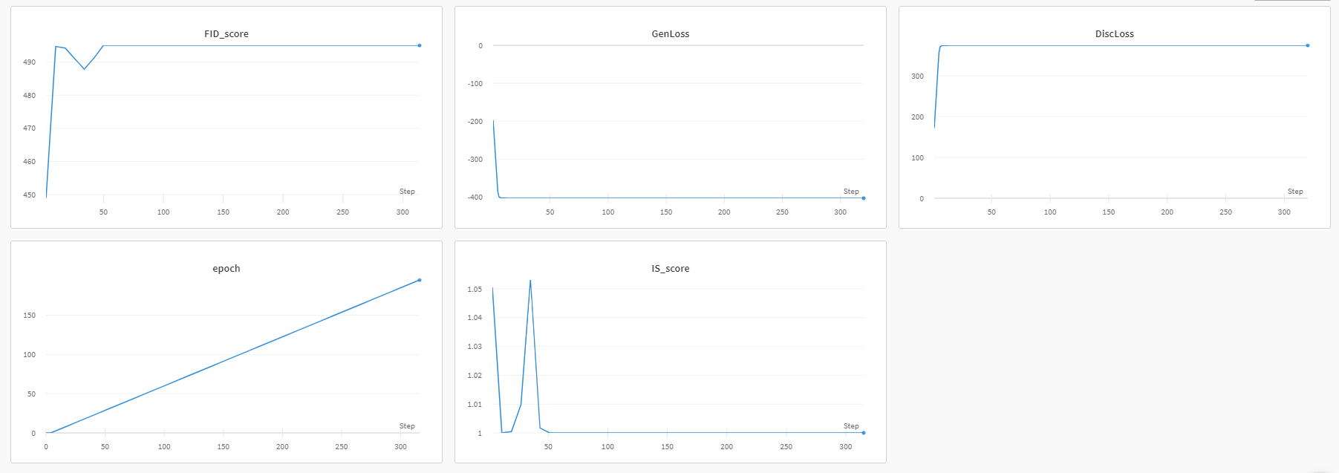
WGAN
Wasserstein GAN minimizes Earth Movers distance rather than Jensen-Shannon divergence
Code was inspired from the technical paper
https://arxiv.org/abs/1701.07875v3
WGAN Used a different loss and architecture from DCGAN
WGAN Failed with FID Score of 496 and IS Score of 1
Images produced were all black and this architecture was not suitable at all

Slide 9
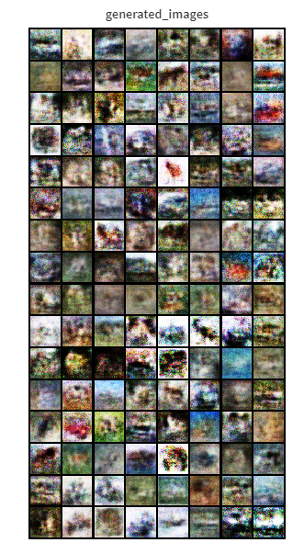
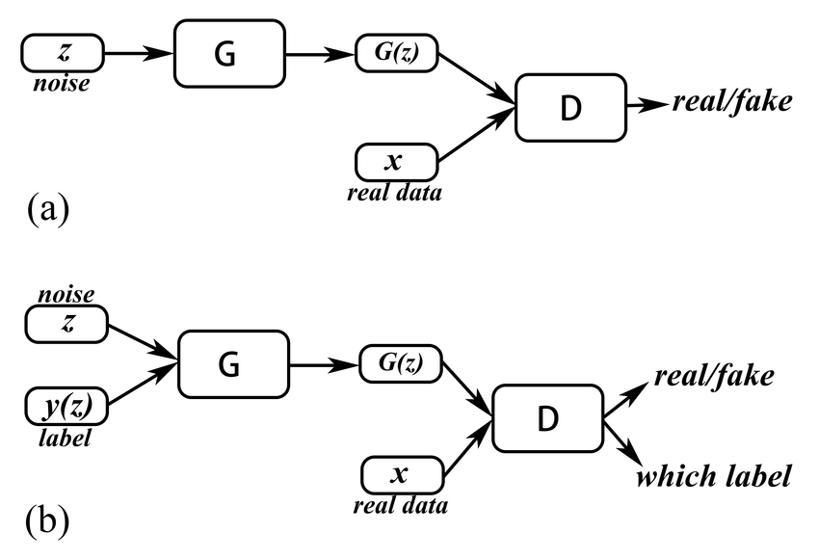
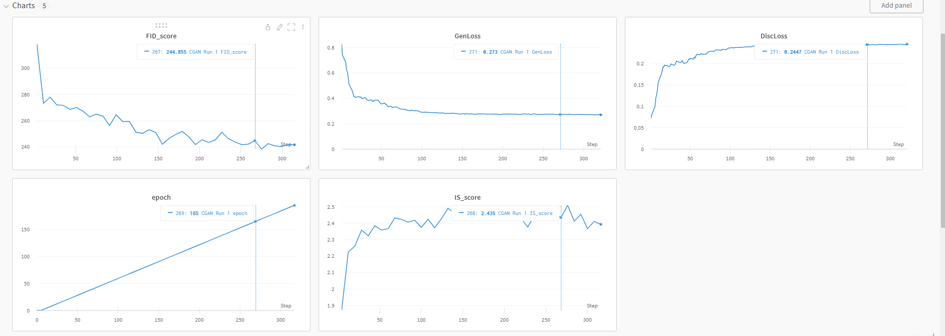
CGAN
CGAN stands for conditional GAN, CGAN was my first conditional GAN which takes advantage of labels in training process, training framework had to be changed for this to work.
Code was inspired from the technical paper
https://arxiv.org/abs/1411.1784
CGAN used a different architecture and of course required labels
CGAN showed good promise with FID: 241 and IS: 2.4
Images produced were not of high quality but CGAN proved to be a possible path

Slide 10
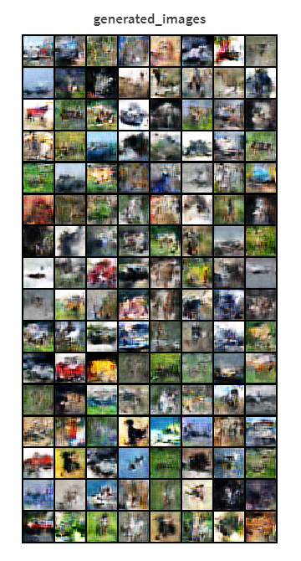
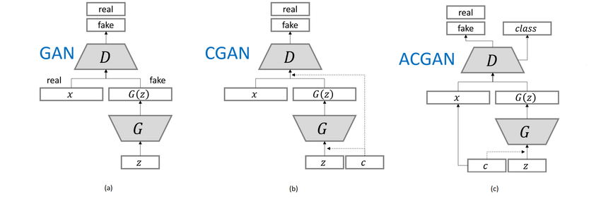
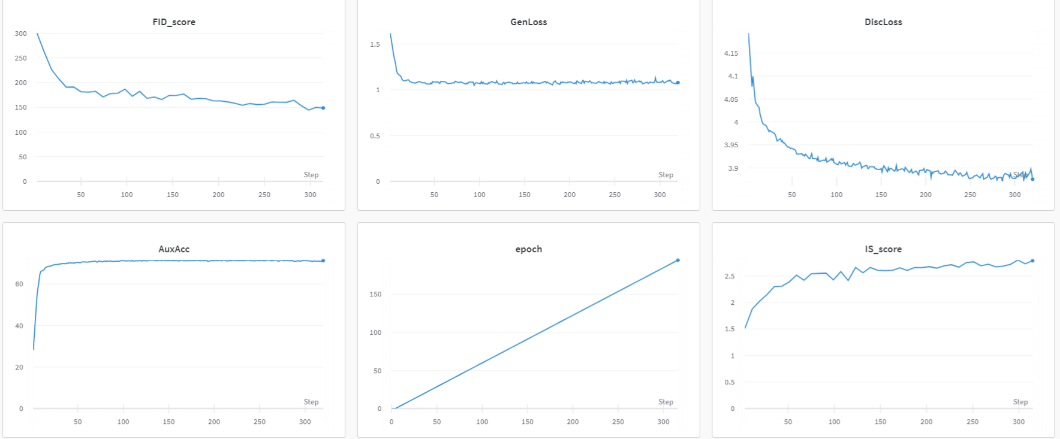
ACGAN
ACGAN stands for auxiliary classifier from CGAN with softmax cross entropy loss.
Code was inspired from the technical paper
https://arxiv.org/abs/2111.01118
AGAN used a different architecture and still required labels
ACGAN FID Score of 148 and IS Score of 2.8
Images produced were better than CGAN as expected and used Aux Acc

Slide 11
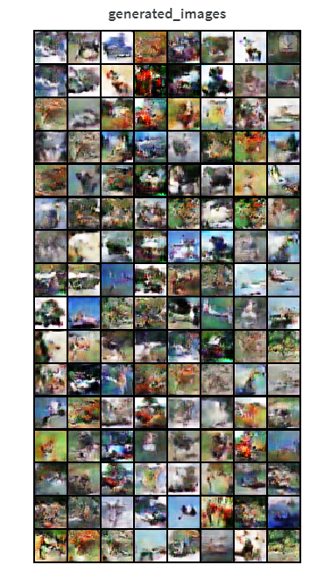
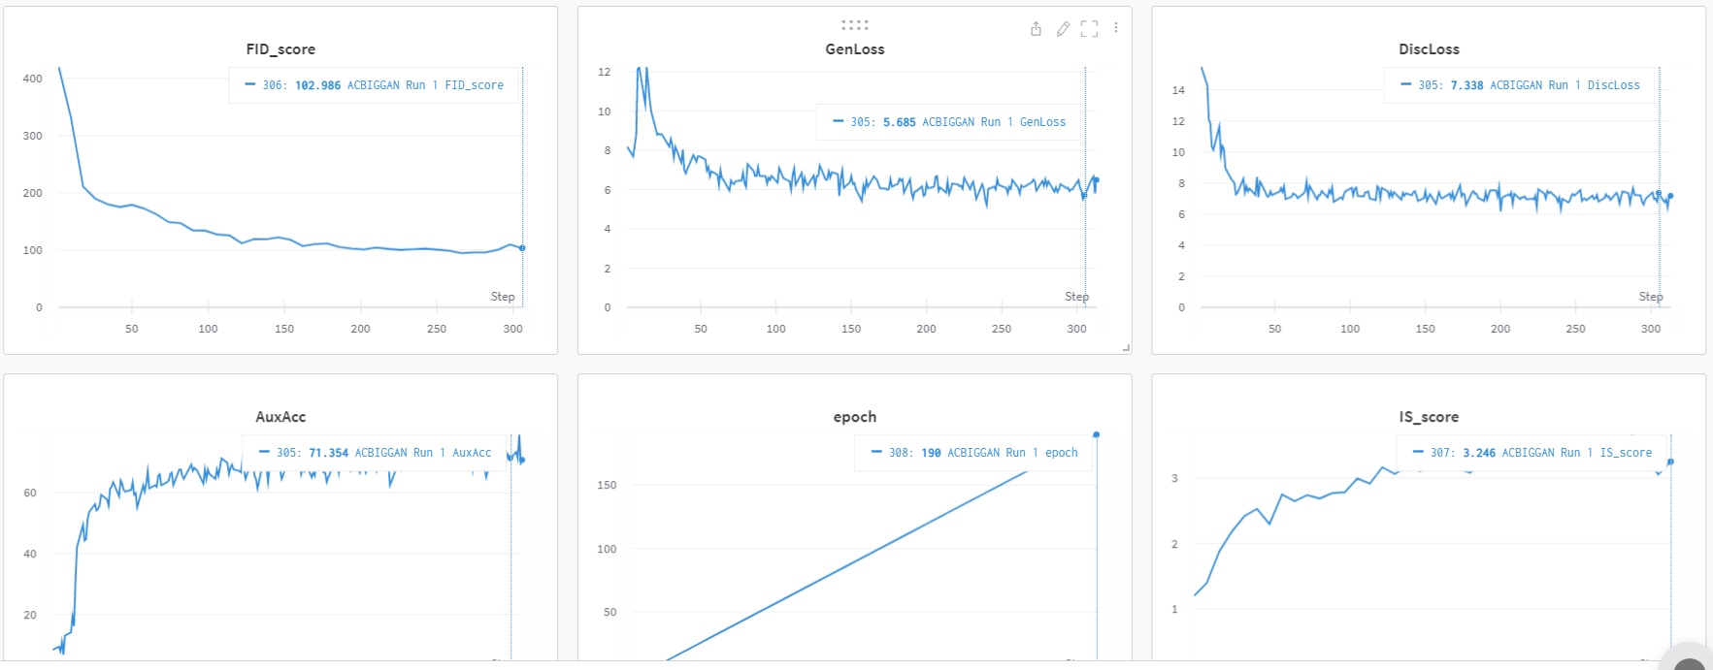
ACGAN Improved with BIGGAN
ACGAN was improved with some inspired architecture from BIGGAN
Used Calculate gradient penalty and BIGGAN discriminator
ACBIGGAN has FID Score of 102 and IS Score of 3.2
Images produced were also of better quality proving that BIGGAN architecture did help

Slide 12
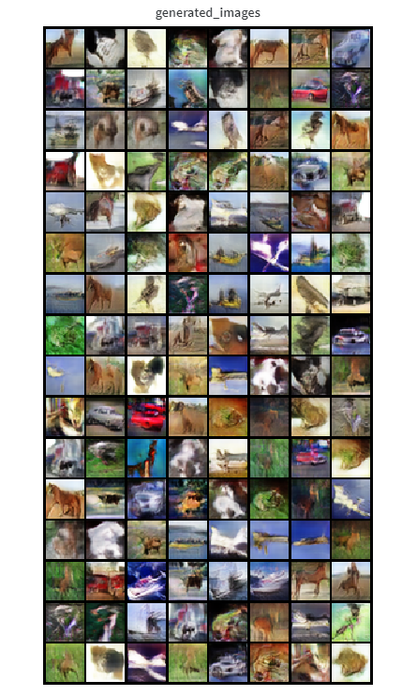
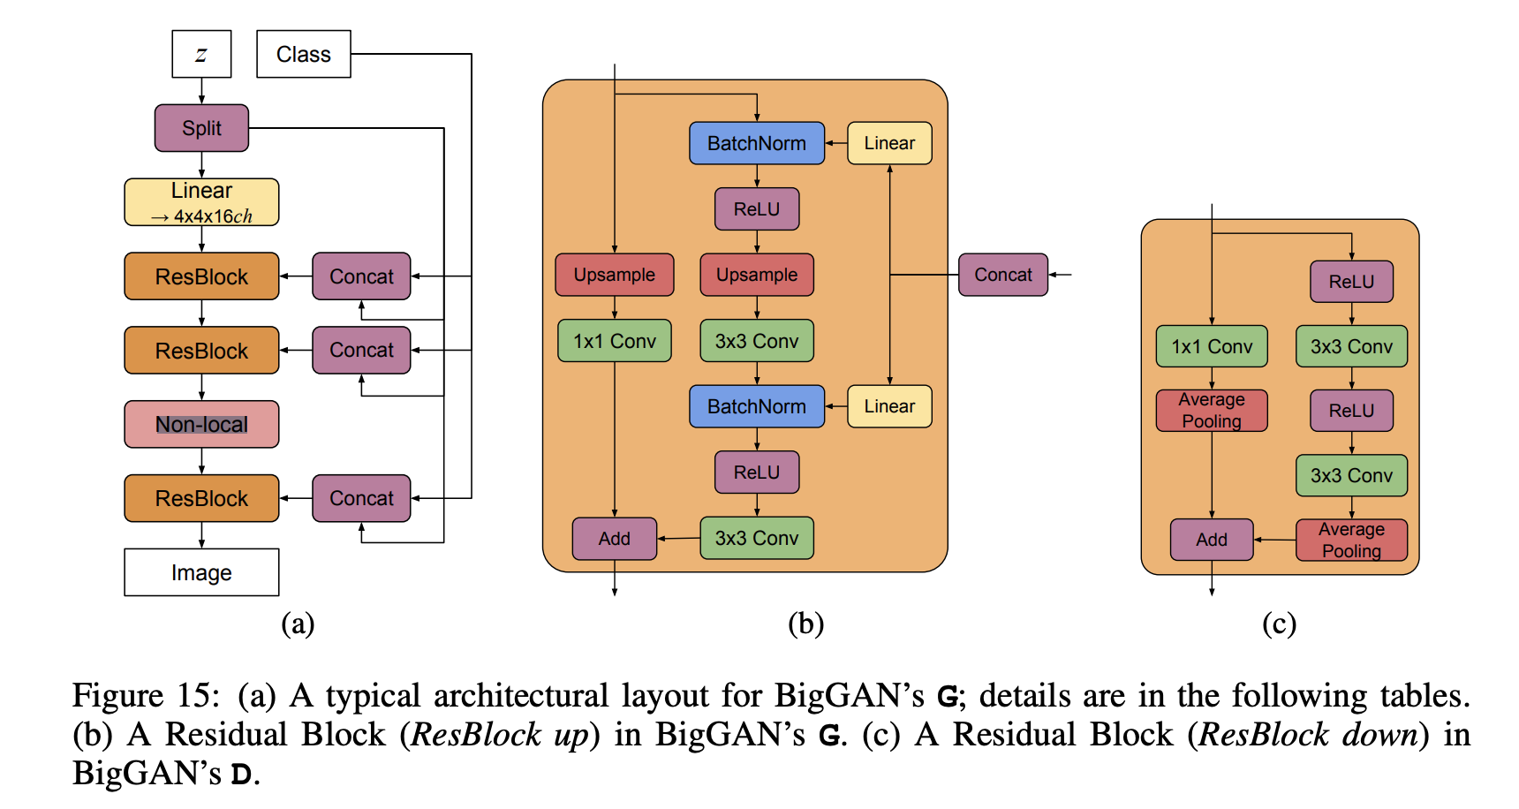
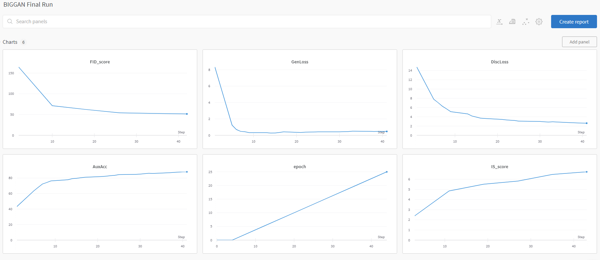
BIGGAN
BIGGAN is the most complex architecture used in this experiment
Code inspired from
https://arxiv.org/abs/1809.11096
Architecture was more complex and used BIGGANConditionalBatchNorm2d and a lot of gen and disc blocks
BIGGAN has FID Score of 46 and IS Score of 6.2
Images produced were of better quality proving that BIGGAN architecture is the best

Slide 13
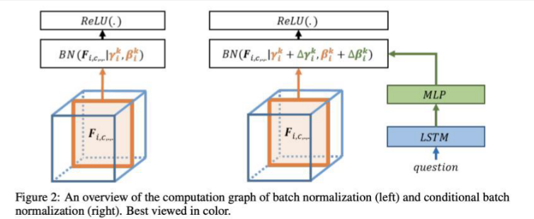
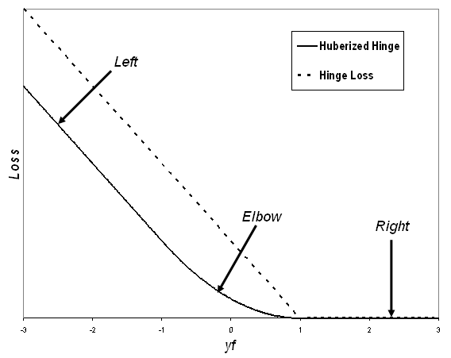
Fine-Tuning
Shared Embedding since it is not as efficient to have different embedding layer transform categorical labels into features which stores class information
Conditional Batch-Norm was used in BIGGAN as bigganconditionalbatchnorm2d
Hinge Loss was introduced from https://github.com/POSTECH-CVLab/PyTorch-StudioGAN/blob/8c9aa5a2e9bb33eca711327c085db5ce50ff7fc0/src/utils/losses.py
Spectral Normalization was used to stabilize training of discriminators by rescaling weight tensor quoted from: https://arxiv.org/abs/1802.05957
Learning Rate scheduler StepLR from pytorch
Label smoothing is introduced as well for classification, CGAN problems to increase generalization and learning speed by making the model not overconfident from: https://arxiv.org/abs/1906.02629

Slide 14
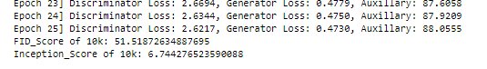
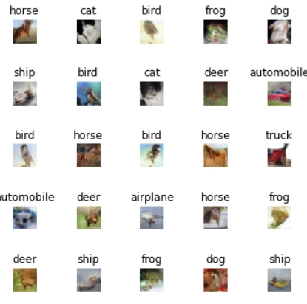
Evaluation
Comparing all the architectures, BIGGAN achieved the best FID and IS Score but requires the longest training times due to the complex network, we will still be going with BIGGAN for the final model.
Evaluating these models we use 2 main metrics: FID Score and IS Score
Inception Score (IS) - Inception score is a metric for automatically evaluating the quality of image generative models (Salimans et al., 2016). Metric was shown to correlate well with hu- man scoring of the realism of generated images from the CIFAR-10 dataset
Frechet Inception Distance (FID) - FID Score is a metric for evaluating the quality of images as well, lower scores correlating to higher quality images while vice-versa for IS Score.
Overall the model managed to generate images that has a decent amount of quality and represents its label’s correctly, example cars can be seen clearly from shape and color. However some mode-colapsing happened where cars generated seem to be the same model.

Slide 15
Conclusion
In Conclusion, I experimented with 5 architectures of DCGAN, WGAN, CGAN, ACGAN and BIGGAN to find that the architecture which performed the best is BIGGAN managing to achieve the FID-Score of 51 and IS-Score of 6.7. The generator loss dropped from 8.3 to 0.47 and the discriminator loss dropped from 14.7 to 2.6, which is good as generator loss should be lower than discriminator loss. The Adversarial Accuracy increased from 43 to 88. With a total of 11 runs comparing all architectures recorded on WandB and a total training time of 49 hours ran on the Colab GPU not including non-listed experimental runs. I have learnt alot about GAN and experimenting with simple architectures such as DCGAN to complex ones such as BIGGAN and all this is done on PyTorch again where I have learnt much from my CA1 to be able to convert my self-taught Pytorch skills here.

